Slide 1
DDOS Attacks (Distributed Denial of Services Attack)
Submitted to – Ms. Richa Kumari
Prepared by:-
Shivansh Nautiyal (2021UCP1181)
Garvit Mittal (2021UCP1144)

Slide 2
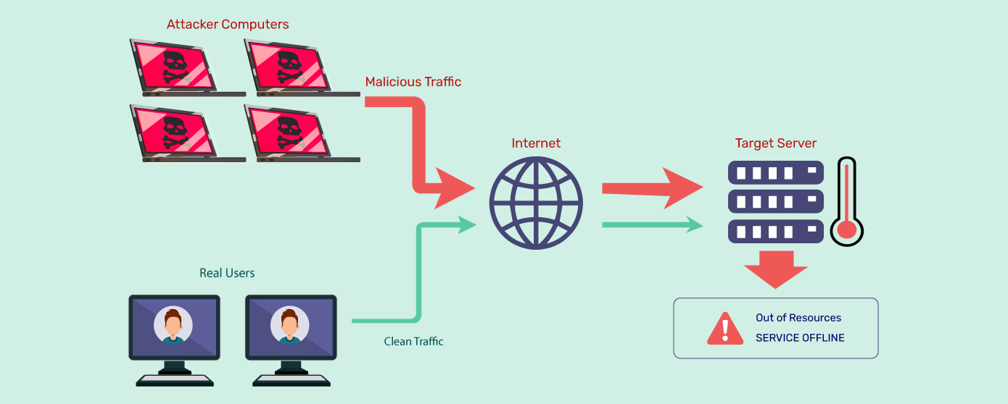
Objective – To perform DDOS Attack for a given I.P. address

Slide 3
Denial of Service Attack: An attack on a computer or network that prevents legitimate use of its resources. A Distributed Denial of Service (DDoS) attack is an attempt to make an online service unavailable by overwhelming it with traffic from multiple sources DoS Attacks Affect: Software Systems Network Routers/Equipment/Servers Servers and End-User PCs

Slide 4
Countermeasures for DoS Attacks-
Software upgrades can fix known bugs and packet filtering can prevent attacking traffic from entering a network.
Shortening the backlog time and dropping backlog connections will free up resources. SYN cookies proactively prevent attacks.
Trace source/destination packets by a means other than the IP address (blocks against IP address spoofing). DNSSEC would provide authorization and authentication on DNS information.

Slide 5
References : https://www.onelogin.com/learn/ddos-attack

